Slide 1


My Experience as an intern

Slide 2
Things to come…

Slide 3

The Company
1 What Pixelding does.
2 Pictures.
3 More pictures.

Slide 4








The Company
1 What Pixelding does.

Slide 5

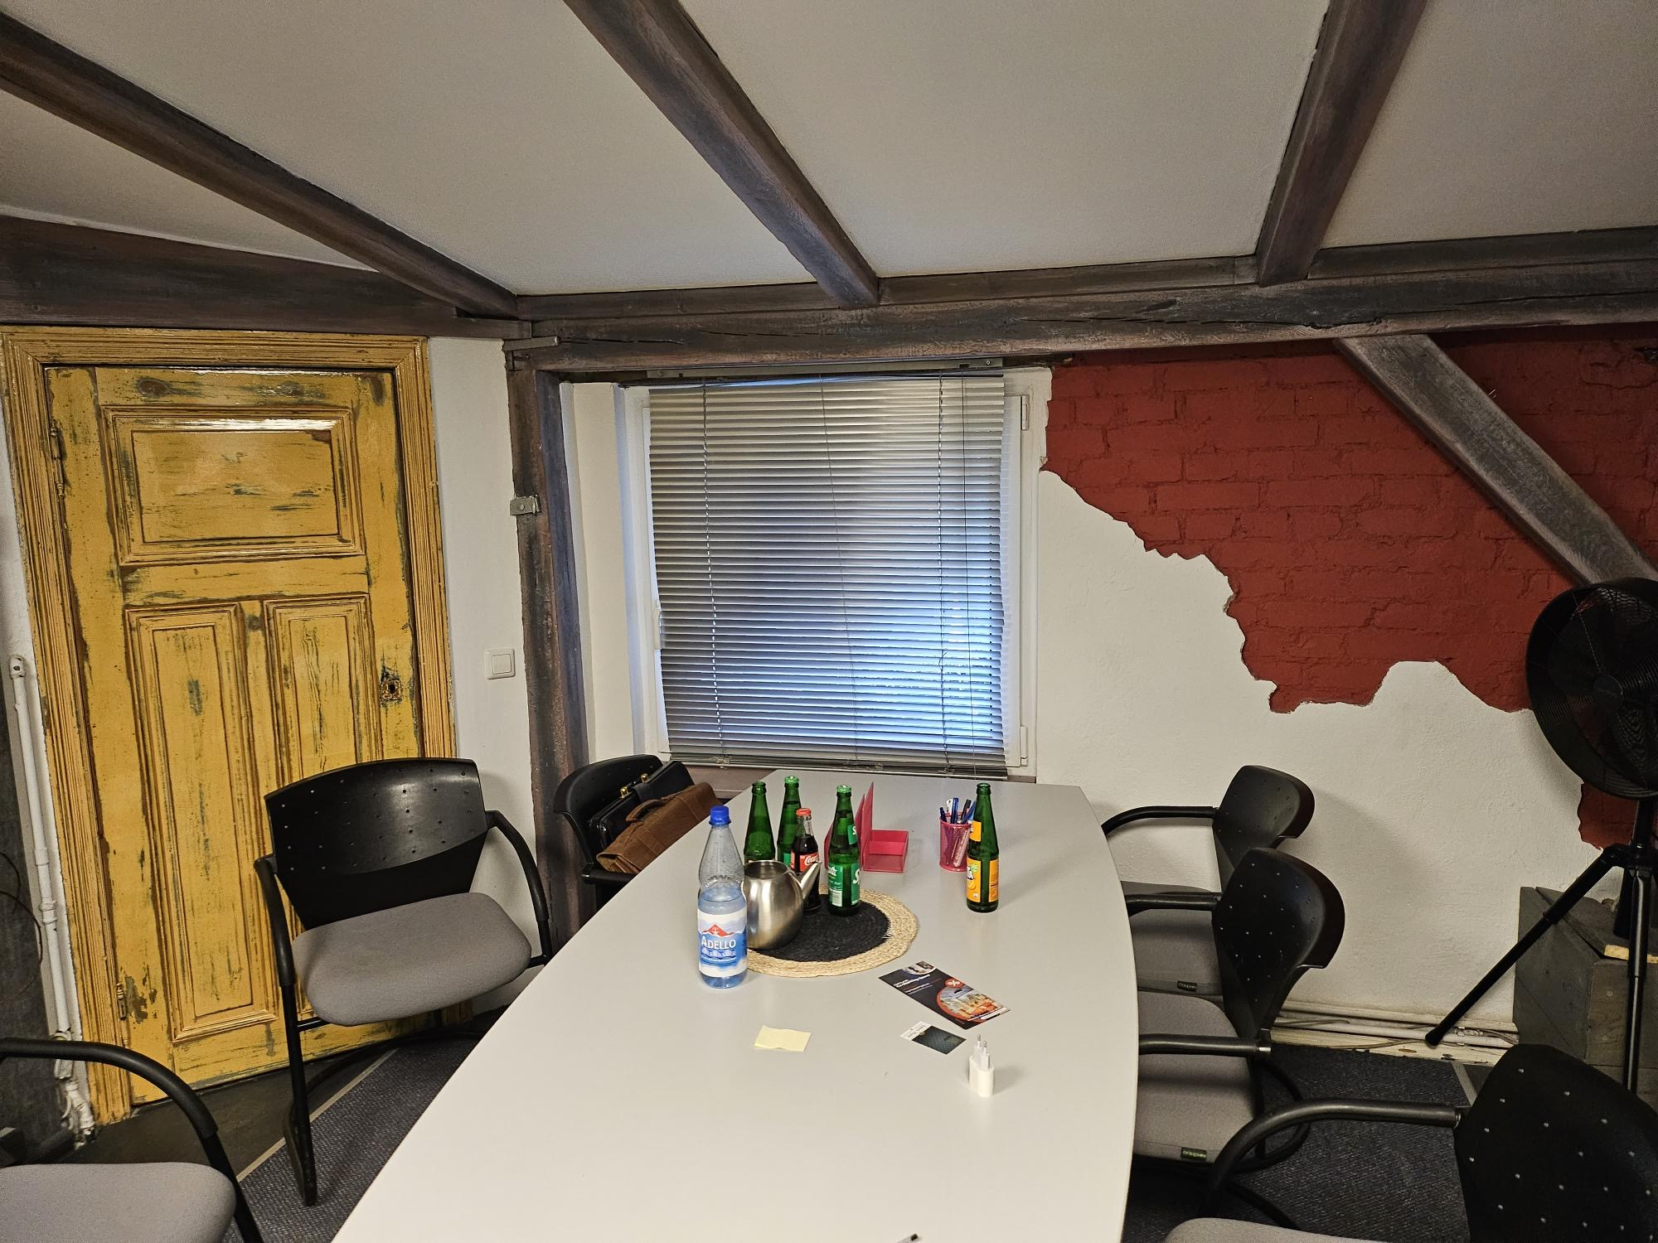
The Company
2 Pictures.

Slide 6
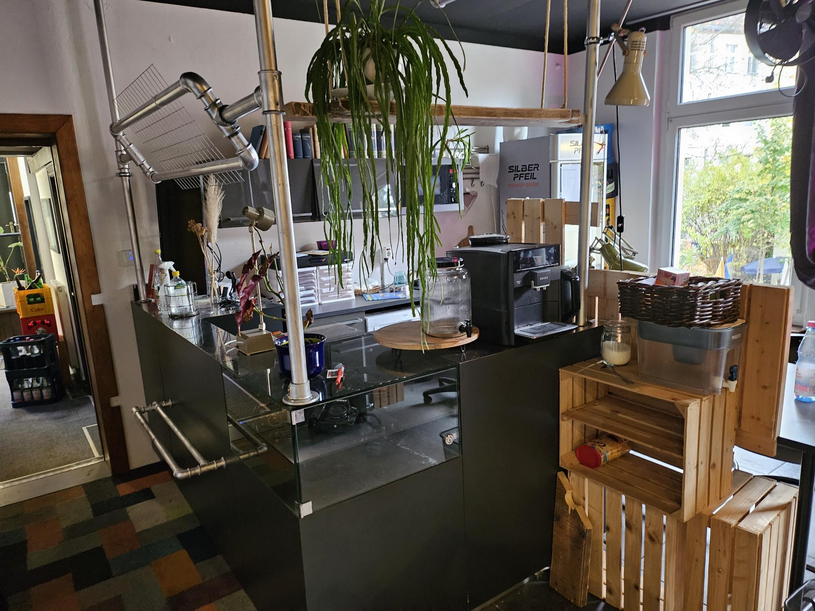

The Company
3 More Pictures!!

Slide 7
My Role and Responsibilities
My position and department.
Specific responsibilities assigned to me.

Slide 8

Projects and Tasks
1 CBD Online Shop.
2 Putzmittel Online Shop.

Slide 9


Projects and Tasks
1 CBD Online Shop.
- Email Benachrichtigung & Airtable update:
on user registration or purchase
With Zapier, and Airtable

Slide 10





Projects and Tasks
2 Putzmittel Online Shop.
- Download infos with Python
- Upload infos with Woocommerce API
as csv to WordPress
+ add Plugins

Slide 11
Team Collaboration
Your interactions with colleagues and team members.
Communication tools used within the company.
Collaborative projects or team achievements.

Slide 12

Technology and Tools Used
1 Software, tools, I knew.
2 Software, tools, I discovered.

Slide 13











Technology and Tools Used
1 Software, tools, I knew.
Collaboration & Communica-tion | Version Control & Code Collaboration | File Storage & Sharing | CMS | Database & Development | Web Hosting & Domain Management | FTP Client
Slack, WhatsApp, Ionos Email, Telefon | GitHub | Google Drive | WordPress WooCommerce | XAMPP Visual Studio Code (IDE) | Ionos | FileZilla

Slide 14




Technology and Tools Used
2 Software, tools, I discovered.
Automation | Database Management | Project Management | Security
Zapier | AirTable | Asana | LastPass (Password Manager)

Slide 15
Skills and Knowledge Gained
Skills you acquired during the internship.
Knowledge gained and how it relates to your academic studies.
Any training or workshops you participated in.

Slide 16
Lessons Learned
Challenges faced and how you overcame them.
Personal and professional growth during the internship.
Any unexpected insights or lessons.

Slide 17
Impact of Your Work
How your contributions affected the team or the company.
Quantifiable results, if applicable.
Positive feedback or recognition received.

Slide 18
Conclusion
Summary of your key points.
Express gratitude to the company and colleagues.
Any future plans or reflections.

Slide 19

Q&A
Dont ask for question if u dont want to hear the answer
Dont ask for question if u dont have the answer

